Slide 1


Session 5. Local Fields and Local Tables
Transact (T24) Technical Induction Training
Minsk, 2021

Slide 2




Agenda
Local Fields overview
Creation of Local Fields and their settings
Adding Local Fields to Applications
Multi-value Local Fields and block of Fields
Local Tables creation: Dynamic Applications, adding User Procedures to Dynamic Applications
Workshops

Slide 3


Scenario 1 - Need for Local Fields
Customer has deposited 1 million $ in his account with the bank. The bank wants to tag him as a valuable customer, in his customer profile. But there is no field in customer application for marking this information. So what does the bank do?
T24 allows us to insert user-defined fields in an existing application. We can do this, without a single line of code.

Slide 4

What are Local Fields?
What?
Local fields are user-defined Fields
Can be reused across various applications
Why?
Banks will want to store extra information which may not be relevant in other banks
Notes:
T24 applications are self consistent and provide the end user with all the necessary fields to store data pertaining to an application in general. Certain banks might want to record some extra information with regard to an application which cannot be recorded while using standard fields. So then, what would the bank do? Can it request Temenos to add some new fields to the application code to store extra information? No. Temenos might not do that, simply because not all the banks would need that field. Then what is the solution? To cater to such situations, Temenos has introduced Local Ref Fields which can be created in the particular client environment to meet their need without affecting the actual application code.
Local fields are user defined fields and are totally customisable by the end user.
Once these local fields are created, they can be reused in various applications accross T24.

Slide 5
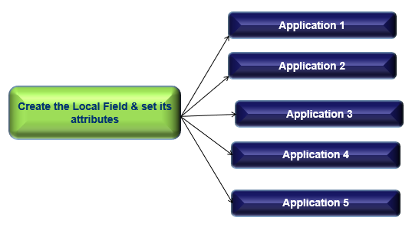
Applications Required
Notes:
To create a local field in T24, you will need to access two applications. LOCAL.TABLE and LOCAL.REF.TABLE
1.1 The application LOCAL.TABLE is used to create the user defined field and set properties of that field.
1.2 LOCAL.REF.TABLE is used to link the newly created field to any T24 application.
The process of creating the field is stand alone and therefore a field created can be reused in any application in T24. You will learn to create a local field and attaching it to an application in the next few slides.

Slide 6
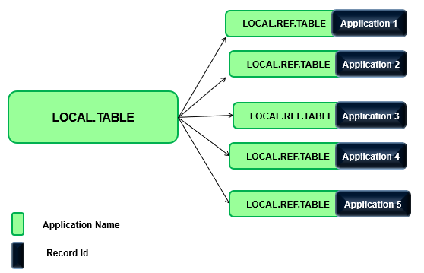
Applications Required
Notes:
To create a local field in T24, you will need to access two applications. LOCAL.TABLE and LOCAL.REF.TABLE
1.1 The application LOCAL.TABLE is used to create the user defined field and set properties of that field.
1.2 LOCAL.REF.TABLE is used to link the newly created field to any T24 application.
The process of creating the field is stand alone and therefore a field created can be reused in any application in T24. You will learn to create a local field and attaching it to an application in the next few slides.

Slide 7
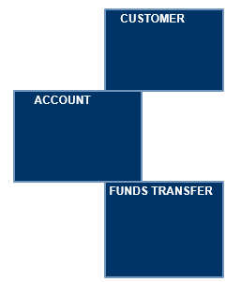
Reusability
Why do we have 2 tables?
Why not just one table to create, as well as attach the field to an application?
Reusability!
NEW FIELD
You can create just one field and use it in as many applications you want

Slide 8
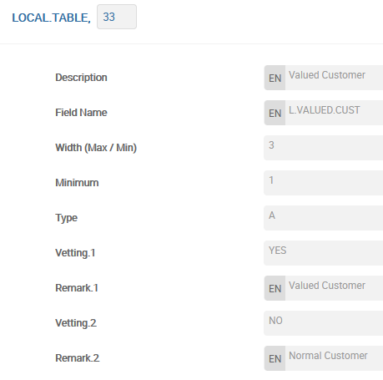
LOCAL.TABLE
Create a record in application LOCAL.TABLE for the field “valued Customer“:
SHORT.NAME field will hold the actual name of the field that you want to create.
If a value is defined in MINIMUM.CHAR field, then the local field becomes a mandatory field.
If you want to pre define values that can be stored in this field, then you can enter possible values in the field VETTING.TABLE
REMARK field is used to store the enrichment for the value in the VETTING.TABLE field.
Notes:
You will now learn to create a local field. The ID of a record in this application was numeric until R09 but from R10 it need not be numeric.
The field DESCRIPTION holds the description of the field.
SHORT.NAME field will hold the actual name of the field that you want to create. The value given in this field will appear in the application you will attach this field to.
MAXIMUM.CHAR and MINIMUM.CHAR fields are used to denote the maximum and minimum number of characters the local field can hold. If a value is defined in MINIMUM.CHAR field, then the local field becomes a mandatory field.
The field CHAR.TYPE holds the information about what type of data can be input in the local field created.
If you want to pre define values that can be stored in this field, then you can enter possible values in the field VETTING.TABLE which can be multi valued to store multiple values. However, it is not mandatory to pre define values into a field.
REMARK field is used to store the enrichment for the value in the VETTING.TABLE field.

Slide 9
LOCAL.TABLE
List of values for Local Field (Vetting Table)
Notes:
Vetting table Fields - can create input options. These can be predefined. For example, Yes – VALUED CUSTOMER, No – NORMAL CUSTOMER or True/False answers.
These options should be the only selection for this field. This will display a selection box.

Slide 10
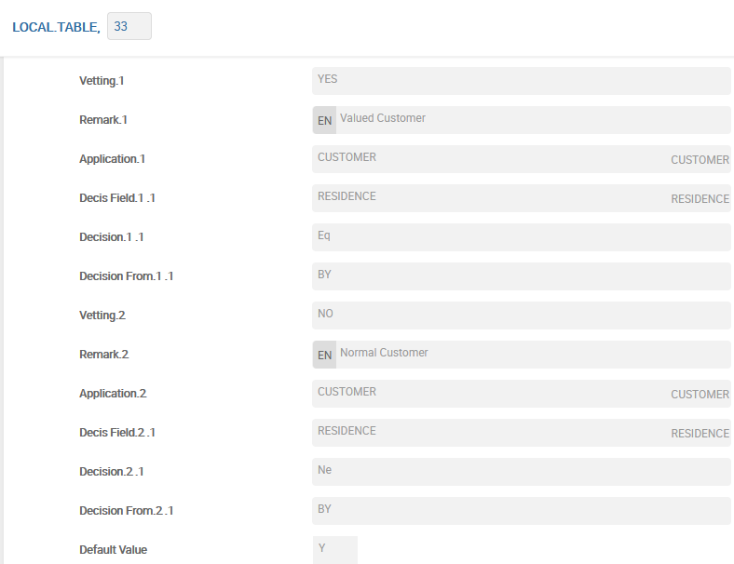
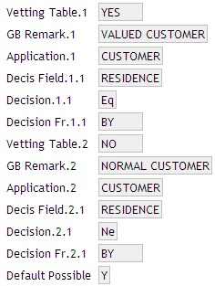
Automatic filling – Decision Making
Local Fields can be automatically filled in accordance with conditions for decisions that are defined in the fields of application LOCAL.TABLE
Field DEFAULT.POSSIBLE must be filled with the value ‘Y’
Notes:
Decisions can also be made using Local Reference Fields.
The decisions are based on the information defined in Fields 8 - 14. These could also be linked to other fields within the Application.
If Field DEFAULT.POSSIBLE is to be used, then it must be set to “Yes” – otherwise leave it blank

Slide 11
Local Fields – Other Characteristics
Application, in which there will be made validation of data inputted into the Local Field
Input is prohibited when the field VETTING.TABLE is filled
Field Number in application that defined in field APPLICATION.VET, that will be used as enrichment for data inputted in Local Field
Prohibition for User to input or change the value inputted in the field
Field MINIMUM.CHAR must be empty
Notes:
Field APPLICATION.VET - would look to the Application to validate the field.
NOTE - If you are using this field you cannot put anything in field 6-14 as the attributes will be set from the table you are attaching.
Field APPL.ENRICHMENT.FIELD - would use the enrichment from another Application and not from the field you have selected.
For example, in ACCOUNT Application you would use the account number, but would use the enrichment from the CUSTOMER Application. Thereby seeing John Smith in the enrichment and not the account number.
Using Field NOINPUT.CHANGE - The User would not be able to input or change any of the data. This would just default data as requested.
NOTE – Field Minimum Character - Would not be used.

Slide 12
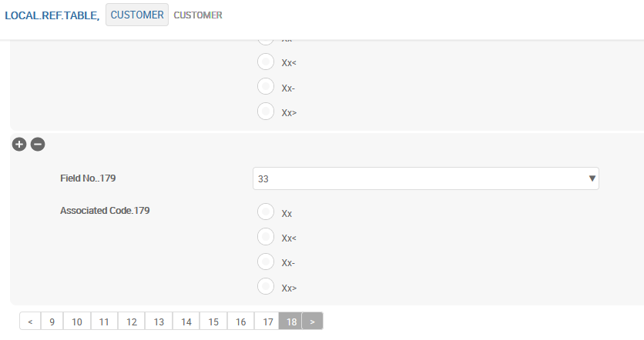
LOCAL.REF.TABLE
LOCAL.REF.TABLE is used to link the local field to an application.
Notes:
Now you are ready with the local field created which needs to be attached to an application. LOCAL.REF.TABLE is used to link the local field to an application. The ID of a record is the application name to which you want to attach the local field.
The field LOCAL.TABLE.NO is used to attach the ID of LOCAL.TABLE application.
SUB.ASSOC.CODE field is used to denote whether this local field is a multi value field or a part of associated multi value set. Possible values in this field are as follows.
XX. denotes that this is a single Multi Value field.
XX< denotes the start of an associated multi value set.
XX- denotes that this is part of an associated multi value set.
XX> denotes the end of the associated multi value set.
If nothing is mentioned in this field, then it is a normal field in an application.
There are only two fields in this application which forms a multi value set.
Note that you cannot change the order of local fields. If you try to add a new local field in between the existing local fields, you will not be able to commit the record. Also, a local field once created cannot be deleted. Therefore care should be taken before deciding to create one local field.

Slide 13
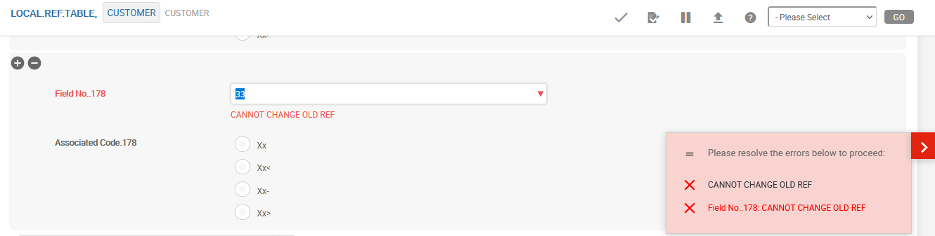
LOCAL.REF.TABLE
Order of local fields cannot be changed. Also, a local field once created cannot be deleted.
Notes:
Now you are ready with the local field created which needs to be attached to an application. LOCAL.REF.TABLE is used to link the local field to an application. The ID of a record is the application name to which you want to attach the local field.
The field LOCAL.TABLE.NO is used to attach the ID of LOCAL.TABLE application.
SUB.ASSOC.CODE field is used to denote whether this local field is a multi value field or a part of associated multi value set. Possible values in this field are as follows.
XX. denotes that this is a single Multi Value field.
XX< denotes the start of an associated multi value set.
XX- denotes that this is part of an associated multi value set.
XX> denotes the end of the associated multi value set.
If nothing is mentioned in this field, then it is a normal field in an application.
There are only two fields in this application which forms a multi value set.
Note that you cannot change the order of local fields. If you try to add a new local field in between the existing local fields, you will not be able to commit the record. Also, a local field once created cannot be deleted. Therefore care should be taken before deciding to create one local field.

Slide 14
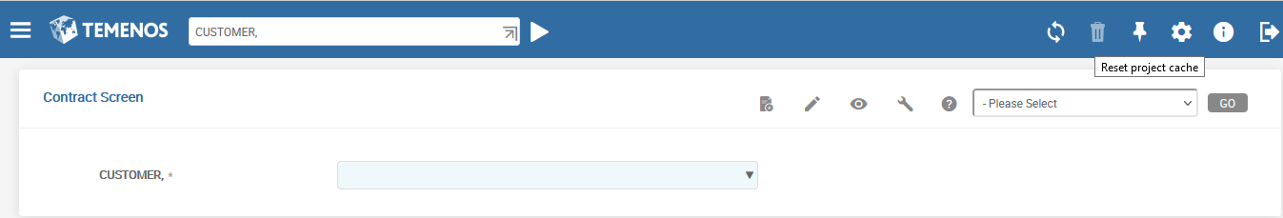
LOCAL.REF.TABLE
After committing LOCAL.REF.TABLE record click «Reset project cache» icon to make the Application renewed.
Notes:
Now you are ready with the local field created which needs to be attached to an application. LOCAL.REF.TABLE is used to link the local field to an application. The ID of a record is the application name to which you want to attach the local field.
The field LOCAL.TABLE.NO is used to attach the ID of LOCAL.TABLE application.
SUB.ASSOC.CODE field is used to denote whether this local field is a multi value field or a part of associated multi value set. Possible values in this field are as follows.
XX. denotes that this is a single Multi Value field.
XX< denotes the start of an associated multi value set.
XX- denotes that this is part of an associated multi value set.
XX> denotes the end of the associated multi value set.
If nothing is mentioned in this field, then it is a normal field in an application.
There are only two fields in this application which forms a multi value set.
Note that you cannot change the order of local fields. If you try to add a new local field in between the existing local fields, you will not be able to commit the record. Also, a local field once created cannot be deleted. Therefore care should be taken before deciding to create one local field.

Slide 15
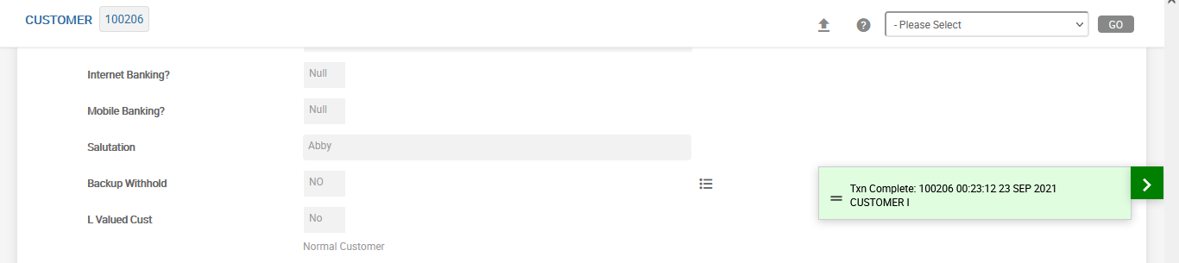
Automatic filling – Decision Making
If CUSTOMER record will be opened and committed, new field L.VALUED.CUST will be filled automatically.
Auto filling
Notes:
Decisions can also be made using Local Reference Fields.
The decisions are based on the information defined in Fields 8 - 14. These could also be linked to other fields within the Application.
If Field DEFAULT.POSSIBLE is to be used, then it must be set to “Yes” – otherwise leave it blank

Slide 16
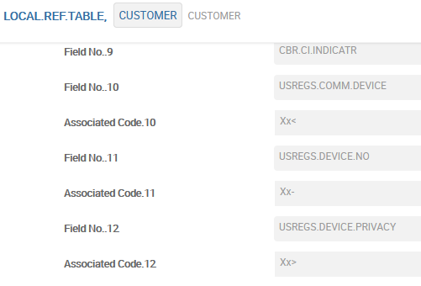
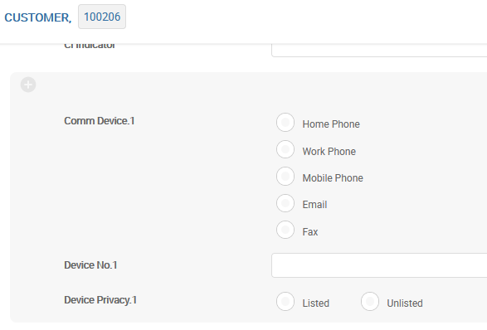
Multi-value Fields, blocks of Fields
Associated Code field is used to denote whether this local field is a multi value field or a part of associated multi value set. Possible values in this field are as follows.
XX. denotes that this is a single Multi Value field.
XX< denotes the start of an associated multi value set.
XX- denotes that this is part of an associated multi value set.
XX> denotes the end of the associated multi value set.
If nothing is mentioned in this field, then it is a normal field in an application.
Notes:
SUB.ASSOC.CODE field is used to denote whether this local field is a multi value field or a part of associated multi value set. Possible values in this field are as follows.
XX. denotes that this is a single Multi Value field.
XX< denotes the start of an associated multi value set.
XX- denotes that this is part of an associated multi value set.
XX> denotes the end of the associated multi value set.
If nothing is mentioned in this field, then it is a normal field in an application.
There are only two fields in this application which forms a multi value set.
Note that you cannot change the order of local fields. If you try to add a new local field in between the existing local fields, you will not be able to commit the record. Also, a local field once created cannot be deleted. Therefore care should be taken before deciding to create one local field.

Slide 17
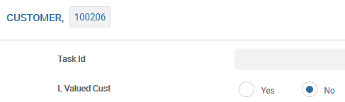
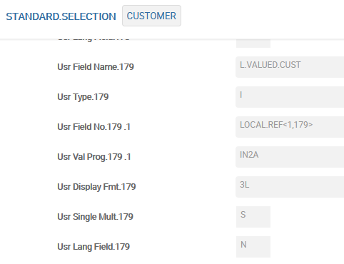
STANDARD.SELECTION
Check STANDARD.SELECTION to see how the local field is updated
Notes:
All the fields that appear on an application will have an entry on the STANDARD.SELECTION record for that particular application. So then, do you have to edit the SS record to add this local field that you have created just now? No. On authorising a record in the LOCAL.REF.TABLE, the corresponding record in SS application will get updated with the relevant data. Take a look at the CUSTOMER record in SS application which is populated with the new field that is created.
Note that the field USR.TYPE is set to ‘I’ which denotes that this is an I-descriptor field and is not stored with this name in the database. The physical field LOCAL.REF has been multi-valued to hold the data of the newly created field. Note that this is the third local field created for this application which is denoted as LOCAL.REF<1,3> in the field USR.FIELD.NO.
The field USR.VAL.PROG contains the name of the IN2 routine that needs to be invoked to perform data type validation. For this specific field the routine IN2A will be invoked as you have set the field CHAR.TYPE to ‘A’ in LOCAL.TABLE application.
The other fields denote the display format and whether it is a single or multi value field and if it is a language specific field.
You are done with creating the local field. So now, you should be able to see the local field in the respective application. You have created a local field VALUED.CUSTOMER and attached it to the CUSTOMER application. Open a new or an existing CUSTOMER record, and you should be able to see the local field created with all the features that you have set in the LOCAL.TABLE and LOCAL.REF.TABLE applications. Note that the local field will be populated even in already existing records in this application and not only in the new records. All the local fields will appear towards the end of the record before the audit fields and in the order as they are created.
Note the enrichment being displayed as defined in the LOCAL.TABLE application.

Slide 18
Things to Remember
The order of the local fields cannot be changed once the LOCAL.REF.TABLE record is authorized
A local field, once specified in the LOCAL.REF.TABLE application (linked to an application), cannot be deleted

Slide 19
Workshop - 1
Add a Local Field to store the Alternate Number in the applications: USER, ACCOUNT, CURRENCY, CUSTOMER, SECTOR, INDUSTRY, FUNDS.TRANSFER, DEPT.ACCT.OFFICER
Add a block of Multi-value Fields in USER application to store any data related to user
Check STANDARD.SELECTION to see how the local fields are updated
Fill in your Local Fields in your USER record

Slide 20
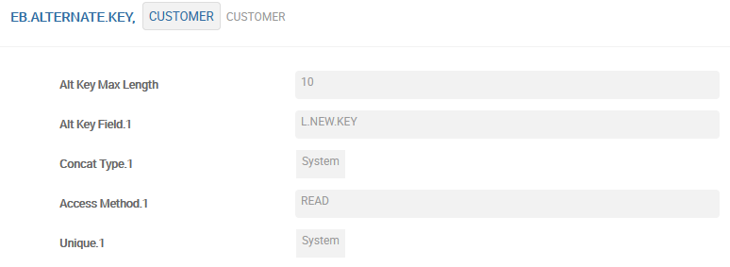
EB.ALTERNATE.KEY
How to define Alternate Key for Application.
Existing field

Slide 21
EB.TABLE.DEFINITION
Application EB.TABLE.DEFINITION allows users to create new Local Table without programming – «Dynamic applications»
Application EB.TABLE.PROCEDURES allows to add user’s procedures to the Dynamic applications (control and automation of data inputted)

Slide 22
Local Tables Characteristics — EB.TABLE.DEFINITION
General Characteristics of EB.TABLE.DEFINITION:
Any number of fields
Predefined set of field types
Multi-value fields (including language fields)
Blocks of related fields
Calculated fields
Applications connected fields

Slide 23
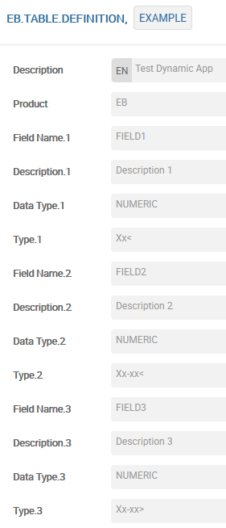
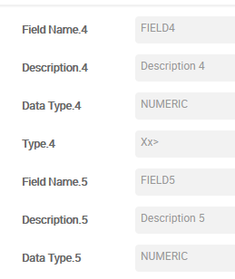
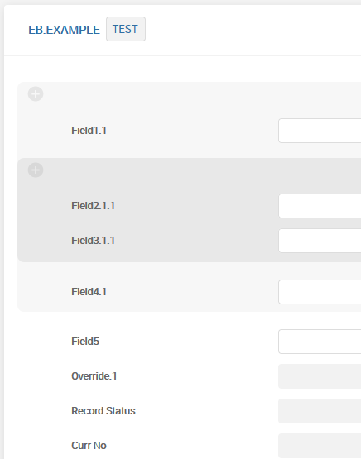
EB.TABLE.DEFINITION
Multi-value group of field inside another Multi-value group of field.

Slide 24
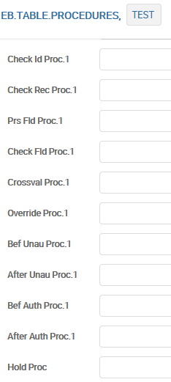
Local Tables Characteristics — EB.TABLE.PROCEDURES
User can define in EB.TABLE.PROCEDURES local routines (programs) for the following cases:
On first initialization of the Dynamic Application
On entry of a record ID
On reading a record from the database
For field level validation
For record level cross validation
In order to provide override processing
Before and after writing an unauthorized record
Before and after writing an authorised record
When placing a record in, or removing a record from hold

Slide 25
Workshop - 2
Create your own Local Table (with any name)
Define any 2-3 fields, including: a) reference to any application (for example: CUSTOMER, CURRENCY etc.) via field Appl Vet.; b) field with pre-defined values (for example: YES\NO) via field Def Value.
Check the correctness, input a record (Note: to launch your Local Table input - <PRODUCT NAME>.<LOCAL TABLE NAME>)

Slide 26
Thank you for your time and attention!
FORANX LLC
Legal address:
35A, Ponomarenko str., 201 office, Minsk, 220015, Belarus
Tel.:+ 375 17 202 76 78
+ 375 17 202 76 79
Fax: + 375 17 362 34 22
Web-site: www.foranx.by
Minsk, 2021

